Slide 1
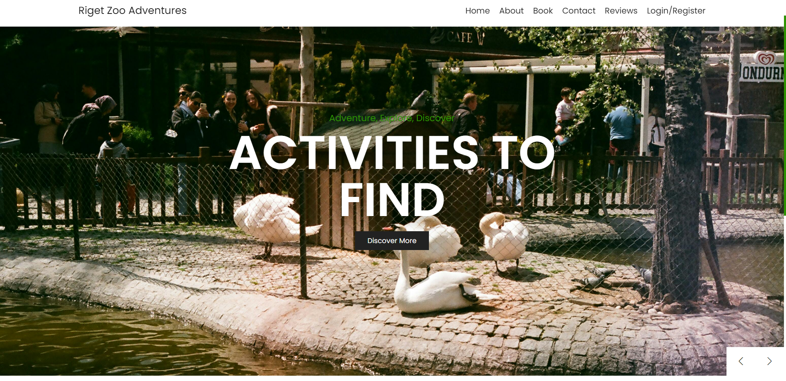
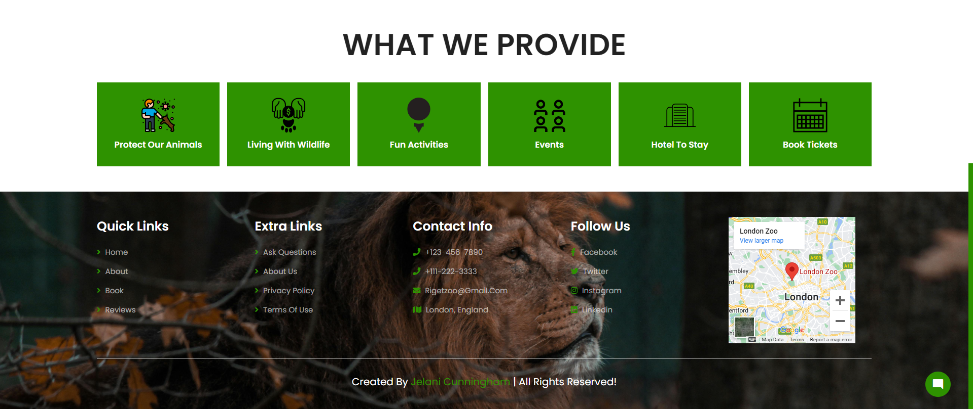
Iteration 1
Slideshow so that users can interact with it
I have icon to state what the website would provide
Chatbot messages icon so that users can interact with it

Slide 2
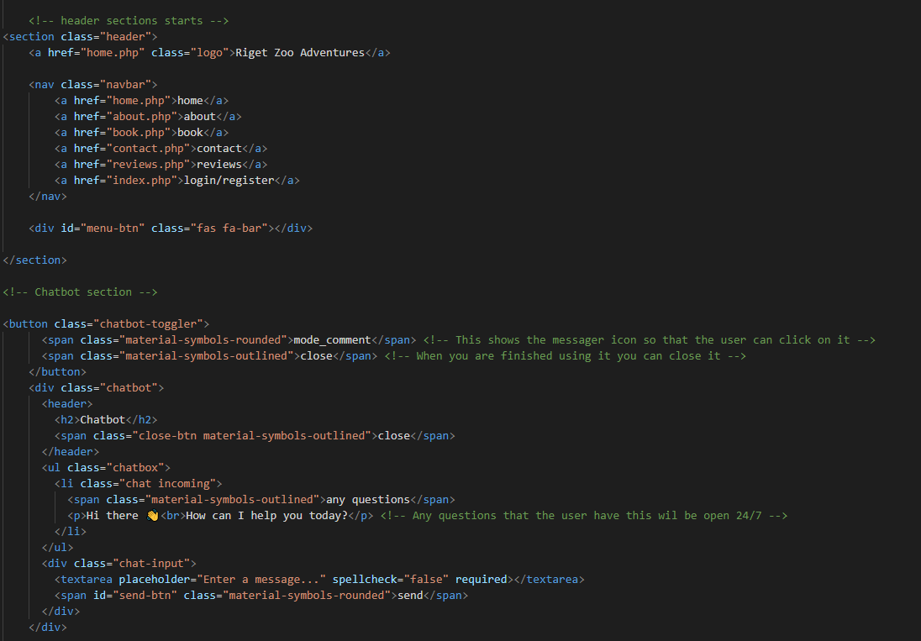
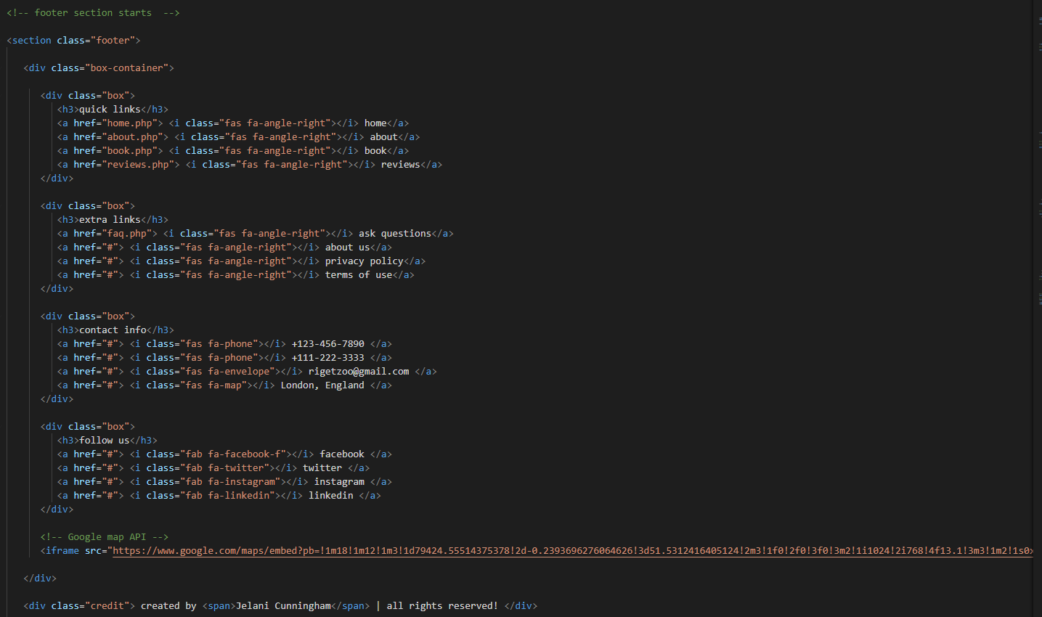
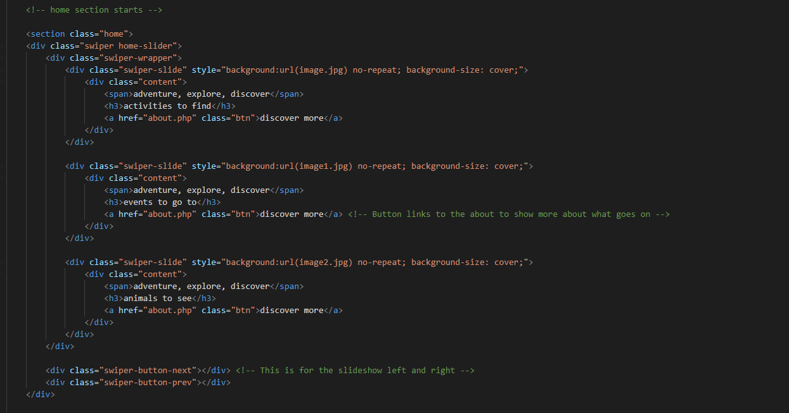
I add the Google Map API to locate where the Zoo is.
I wanted to make sure that my image to cover the top part of the website. Draw in the user with text on there

Slide 3
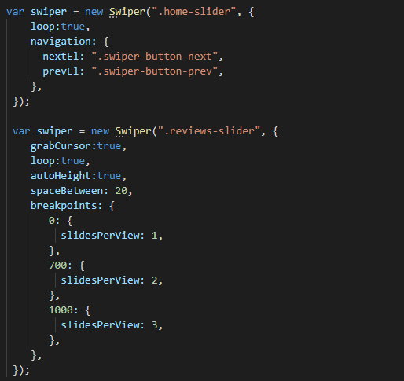
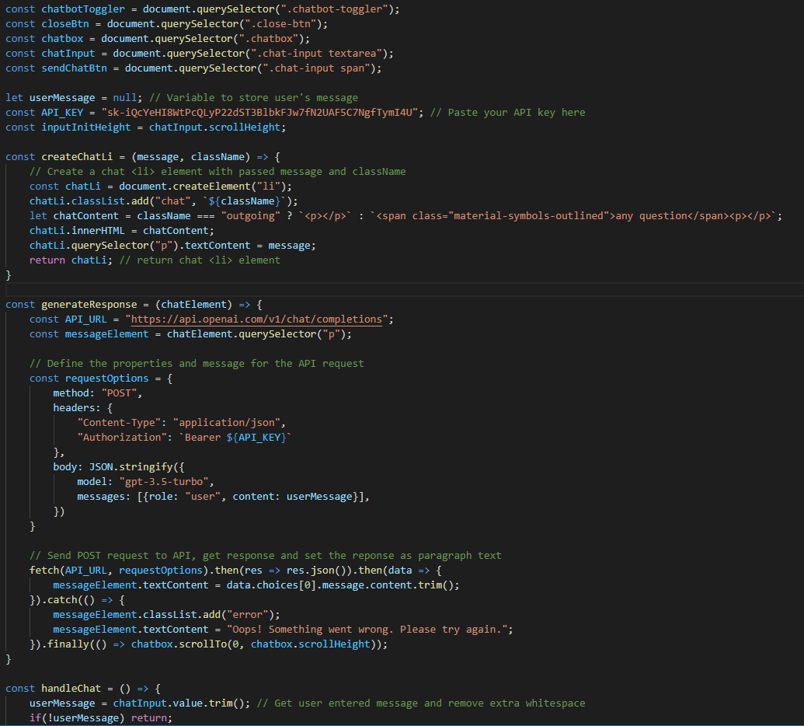
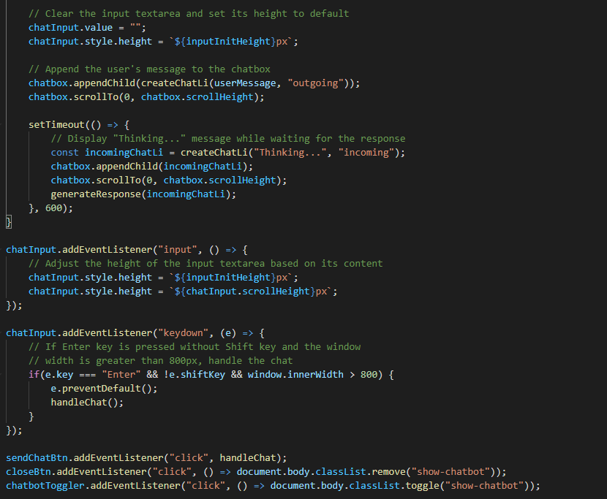
The JavaScript here is used for the arrows so users can go through the different images.

Slide 4
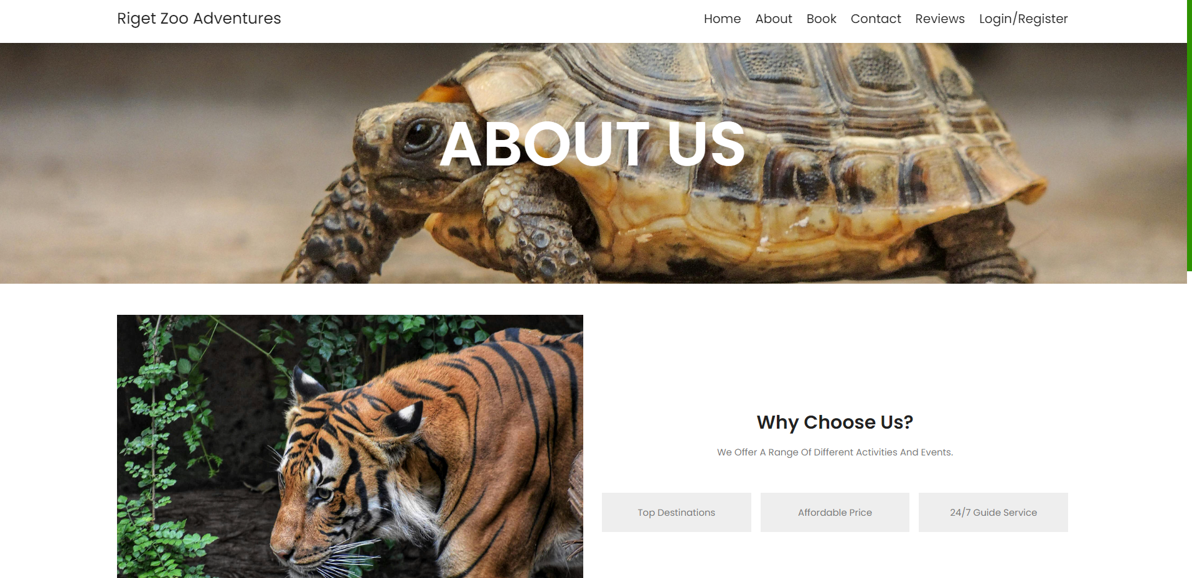
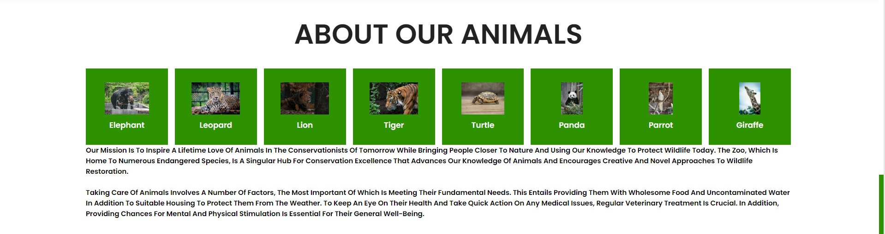
Iteration 2
I add pictures so it can draw in more users experience.
Text about the animals and what how Riget Zoo Adventures take care of there animals.
I showed some of the animals that are featured on the website.

Slide 5
